Slide 1
Progress Report
25.10.22
DongJae Seo

Slide 2
1. Introduction
2. Moment
3. Results
4. Conclusion & Future Works
Contents

Slide 3
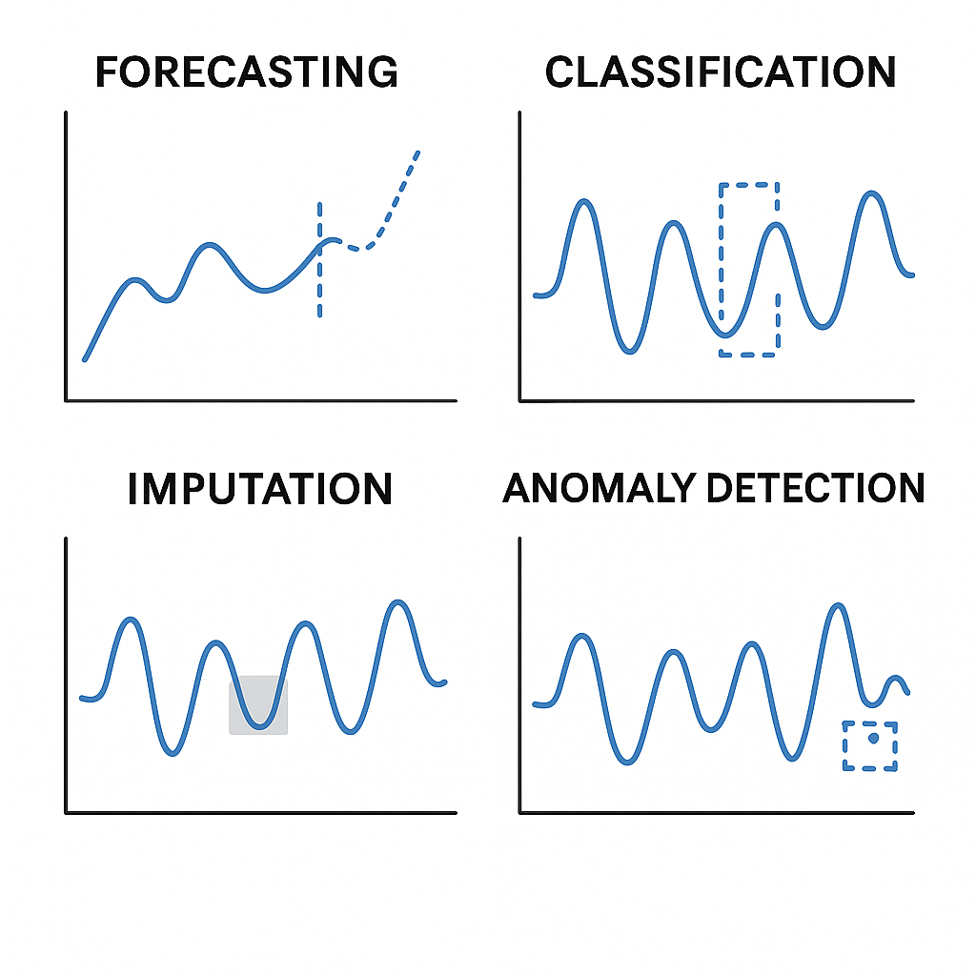
Introduction
Time Series Foundation Model
A large-scale pretrained model designed to handle various time-series tasks
Forecasting, Classification, Imputation, Anomaly Detection
Objective
Sleep stage classification using a Time Series Foundation Model (MOMENT) and PhysioNet data
Performance compared against SleepFM, a model specialized for sleep staging

Slide 4
Introduction
TimesFM (ICML 2024)
Moirai (ICML 2024)
Time Series Foundation Model for forecasting tasks
Mantis (arXiv preprint)
Classification task Foundation Model
Moment (ICML 2024)
Multi-task Foundation Model
Pretrained on biosignal data including EEG and ECG

Slide 5
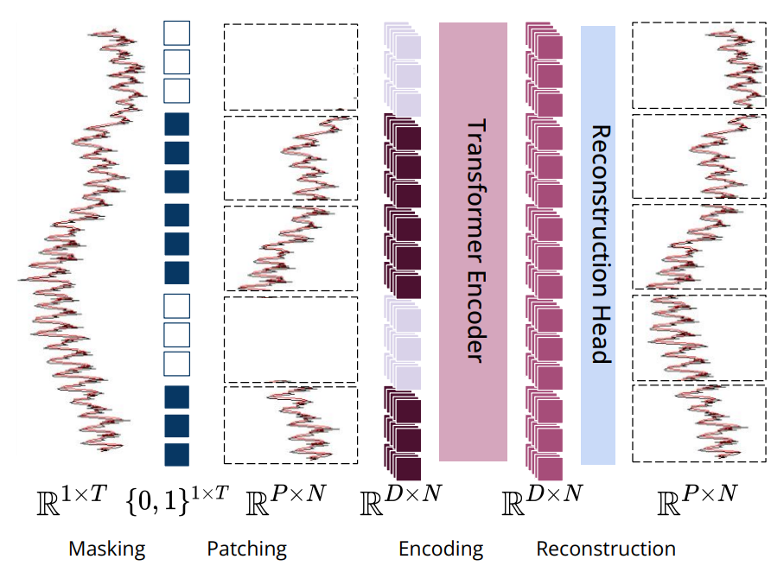
Moment - Model
Model Overview
Masking
Patching
Encoding
Reconstruction

Slide 6
Moment - Model
Model Overview
- Masking
Randomly masks parts of the input time series and learns to reconstruct the missing segments
- Patching
Splits the time series into fixed-length patches so the Transformer can process them

Slide 7
Moment - Model
Model Overview
- Encoding
Learns temporal dependencies between patches and extracts embeddings
- Reconstruction (Pretrain 때만 사용)
Uses Transformer-derived embeddings to reconstruct the masked time series
The goal of pretraining is to learn core time-series patterns through reconstruction

Slide 8
Moment - Model
Task - Classification
The embeddings extracted from the Transformer contain meaningful time-series features
A classifier is trained on top of the pretrained model
MOMENT is a univariate model and can process only one variable at a time
For multivariate data, embeddings are extracted for each channel and averaged
Classifier

Slide 9
Moment - Model & Data Specification
MOMENT processes time-series with a fixed length of 512
PhysioNet data → 1 epoch = 256 Hz * 30 sec = sequence length 7680
Downsample the 7680-length sequence with stride 2 (7680 → 3840)
Crop 1 second from both ends
Split the remaining 28 seconds into 7 chunks (3584 / 7 = 512 per chunk)
Extract embeddings for each chunk using the MOMENT model
1s (128)
4s (512)
1
2
3
4
5
6
7
1 Epoch (30sec)
(3840 sequence after downsampling)

Slide 10
Moment - Model & Data Specification
During inference, average the softmax logits of the 7 chunks to classify the full epoch
Ex: Avg = [0.1, 0.65, 0.1, 0.1, 0.05] -> N1
[.1, .6, .1, .1 .1]
[.1, .7, 0, .1 .1]
...
[.1, .6, .1, .1 .1]
[.1, .5, .2, .1 .1]
1
2
3
4
5
6
7
1 Epoch (30sec)
(3840 sequence after downsampling)

Slide 11
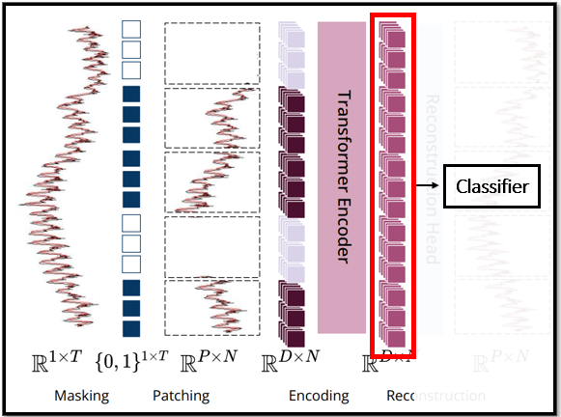
Moment - Experiment
3. Feature Extractor - Trainable
Experimental Setup: PhysioNet Data
No. of Channels – 1 / 3 / 5 channels
Classifier Type - SVM / Linear Classifier
Feature Extractor – Freeze / Unfreeze
No. of Channels
in PhysioNet Data
C3-M2
E1-M2
Chin1-Chin2
Airflow
ECG
1 Channel
3 Channels
5 Channels
2. Classifier Type
SVM – Machine Learning classifier
Linear Classifier – Fully Connected Layer

Slide 12
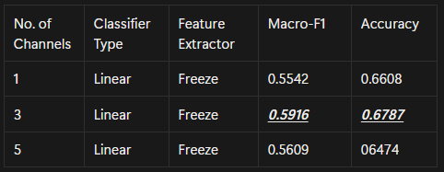
Moment – Experiment
Experiment 1 - Comparing No. of Channels
Best performance observed when using 3-channel data
Channels: C3-M2, E1-M2, Chin1-Chin2

Slide 13
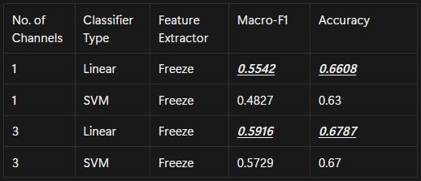
Moment – Experiment
Experiment 2 - Comparing Classifier Type
Linear classifier outperformed SVM

Slide 14
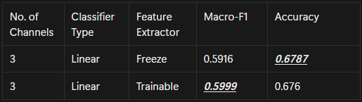
Moment – Experiment
Experiment 3 – Feature Extractor
Feature Extractor fine tune Results
Moment best Macro-F1 = 0.5999
–> 3 channels | Linear Classifier | Trainable Feature Extractor

Slide 15
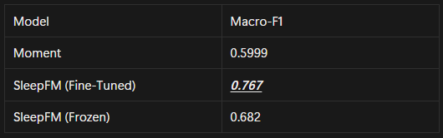
Moment – Experiment
Comparison with SleepFM
Best achieved Macro-F1 for MOMENT and SleepFM
Compared to the best Macro-F1 of SleepFM, SleepFM achieved the higher score

Slide 16
Conclusion & Future Works
Conclusion
Sleep stage classification experiments using the Time Series Foundation Model (MOMENT)
Although the general foundation model performs lower than SleepFM, it still shows meaningful results for sleep staging
Future Works
Foundation models that support multivariate inputs include UniTS and NuTime
Improved performance by modeling transitions across consecutive epochs (Mamba)

Slide 17
THANK YOU!

